Slide 1
Forced Evictions, Gentrification, & Race
Seattle & King County
Tim Thomas, Ph.D
Postdoctoral Fellow
University of Washington
eScience Institute & Sociology
t77@uw.edu
Download this talk at bit.ly/seattleevictions
Notes:
Thank you!
Ecology of Evictions

Slide 2
The History of Neighborhood Formation
Tim Thomas - t77@uw.edu - bit.ly/seattleevictions

Slide 3
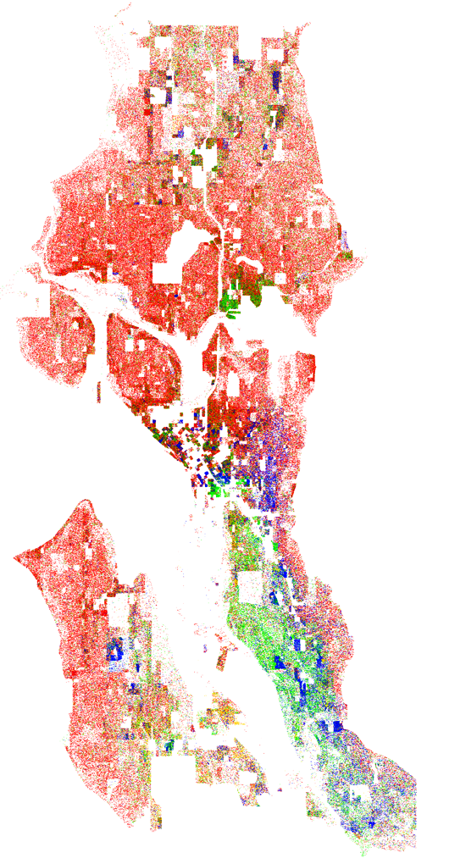
Race & Ethnicity in Seattle
1 Dot = 1 Person
White
2010
African American
Asian
Latinx
Tim Thomas - t77@uw.edu - bit.ly/seattleevictions

Slide 4
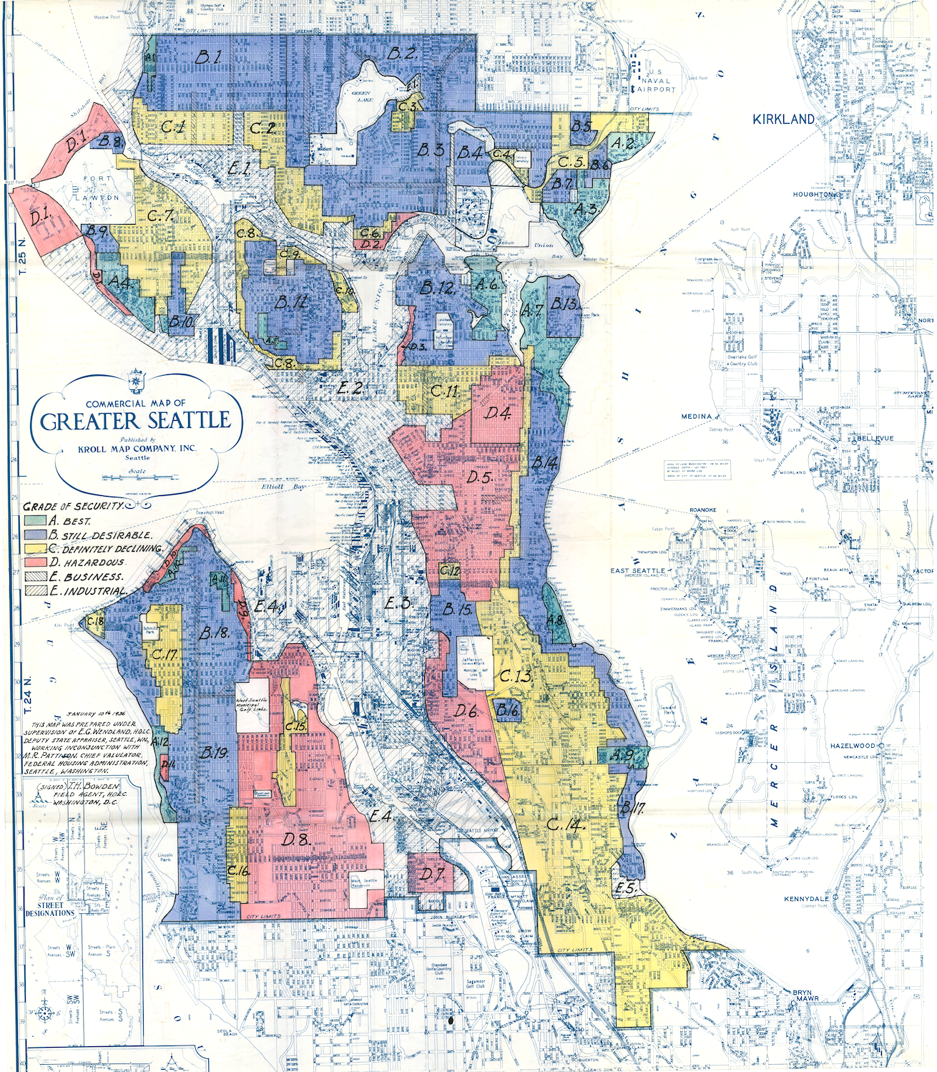
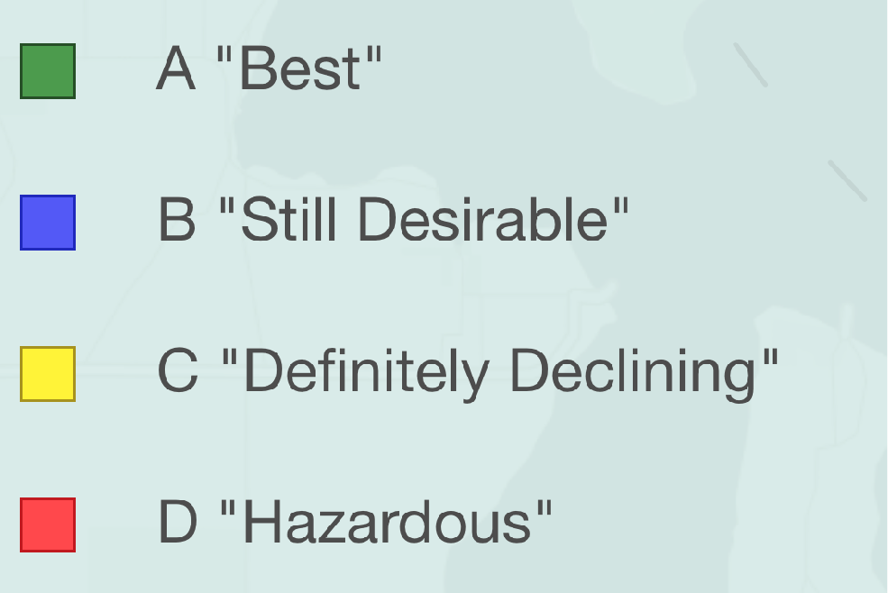
Redlining
Seattle
Home Owners Loan Cooperation
(HOLC) Map: 1930 - 1940
Source: Mapping Inequality https://dsl.richmond.edu
Tim Thomas - t77@uw.edu

Slide 5


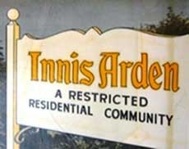
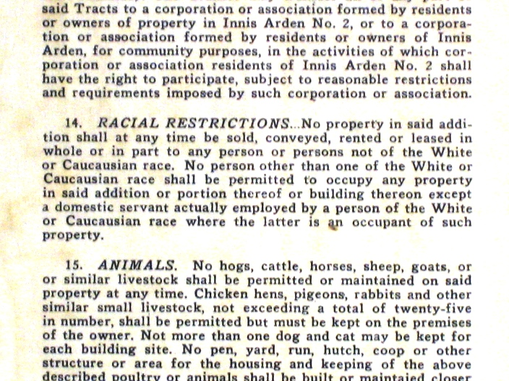
Restrictive Housing Covenants
Over 400 restrictive housing covenants in King County
Source: Seattle Civil Rights & Labor History Project
Tim Thomas - t77@uw.edu - bit.ly/seattleevictions
Notes:
- Tim, refer to pg. 6 of the paper for more detailed information on the various types of buffers.

Slide 6
Seattle Neighborhoods with
Restrictive Covenants
Seattle
Alki
Ballard
Beacon Hill
Bitter Lake
Blue Ridge
Broadmoor
Bryant
Capitol Hill
Central District
Duwamish
Eastlake
Greenlake
Greenwood
Haller Lake
Hawthorne Hills
Lake City
Lakeridge Laurelhurst
Loyal Heights
Madrona
Eastside
Ames Lake
Arrowhead Point
Bellevue
Clyde Hill
Inglewood
Juanita
Kirkland
Lake Alice
Lake Sammamish
Mercer Island
North Bend
Redmond
Sammamish
North King Co.
Ballinger (Shoreline)
Briarcrest (Shoreline)
Echo Lake (Shoreline)
Hamlin Park (Shoreline)
Hillwood (Shoreline)
Innis Arden (Shoreline)
Kenmore
Lake Forest Park
North City (Shoreline)
Richmond Beach (Shoreline)
Richmond Highlands (Shoreline)
Ridgecrest (Shoreline)
Westminister Triangle (Shoreline)
Magnolia
Maple Leaf
Matthews Beach
Montlake
Olympic Hills
North Beach/Blue Ridge
North College Park
Northgate
Pinehurst
Queen Anne
Queen Anne Lower
Queen Anne North
Rainier Valley Ravenna
Sandpoint
Sheridan Beach
Vashon Island
Victory Heights
View Ridge
Wedgewood
West Seattle/High Point
Windermere
South King Co.
Arbor Heights
Arroyo Heights
Auburn
White Center
Boulevard Park
Burien
Des Moines
Evansville
Kent
Lake Dolloff
Maple Valley
McMicken Heights
Normandy Park
Redondo
Renton
Riverton Heights
SeaTac
Shorewood
Tukwila
Source: Seattle Civil Rights & Labor History Project
Tim Thomas - t77@uw.edu
Notes:
- Tim, refer to pg. 6 of the paper for more detailed information on the various types of buffers.

Slide 7
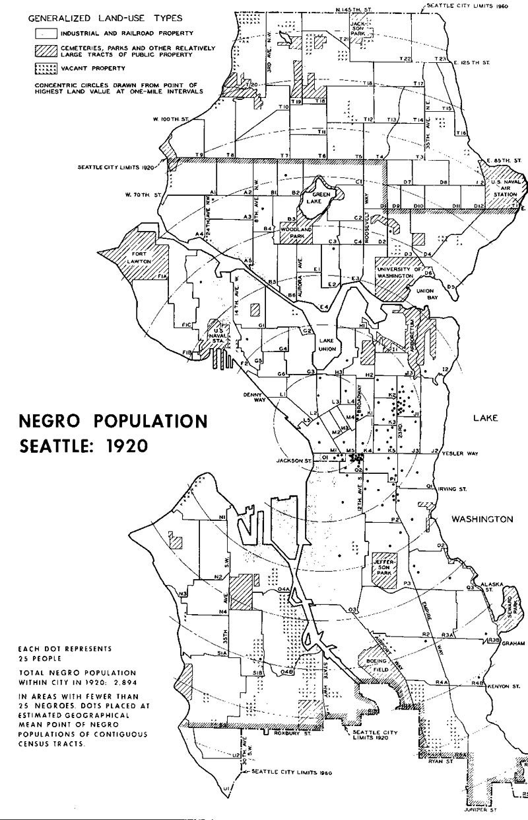
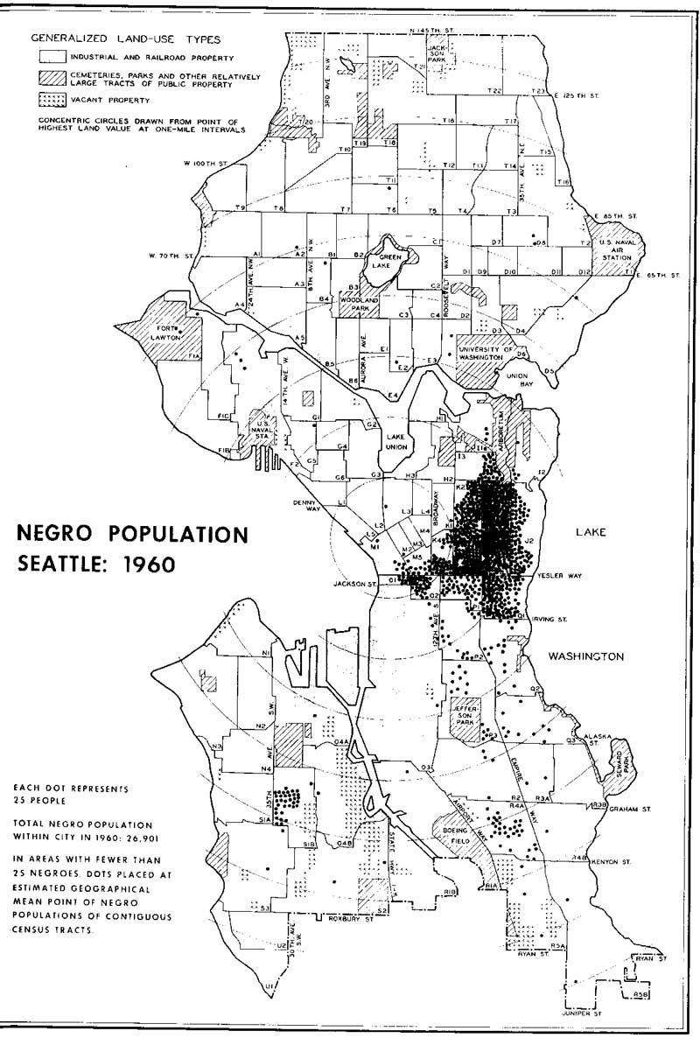
Black Population 1920 - 1960
1920
1960
Source: Seattle Civil Rights & Labor History Project
Tim Thomas - t77@uw.edu

Slide 8

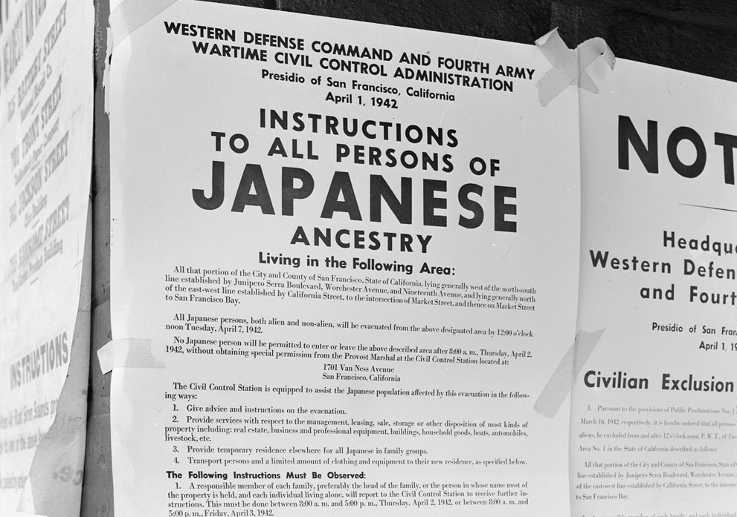

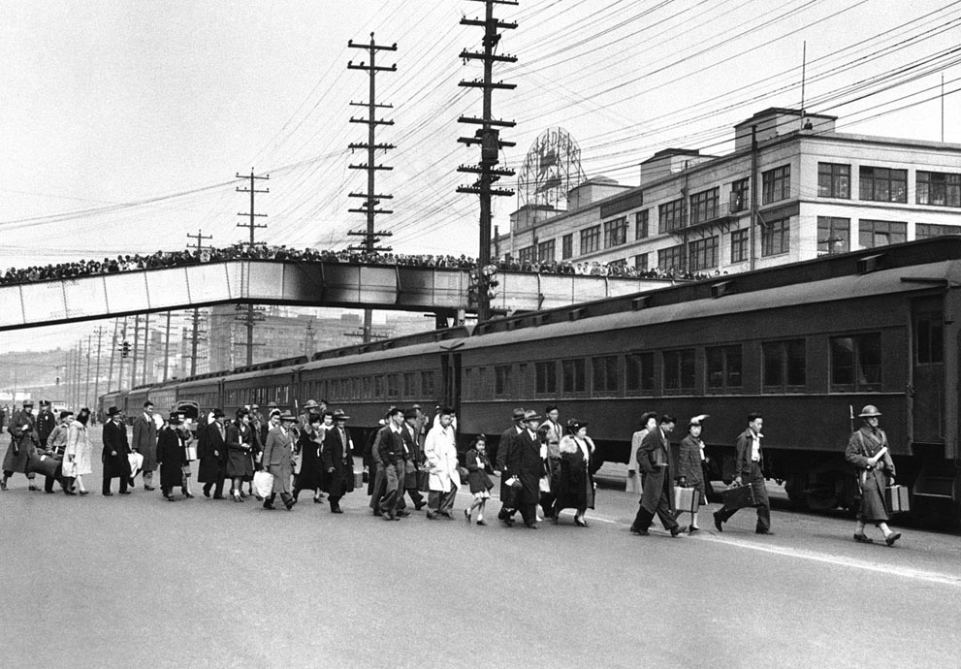
Japanese Internment 1942
1942 Relocation Notice
Seattle Mass Evacuation
http://peopleus.blogspot.com/2010/10/japanese-internment-at-manzanar.html

Slide 9

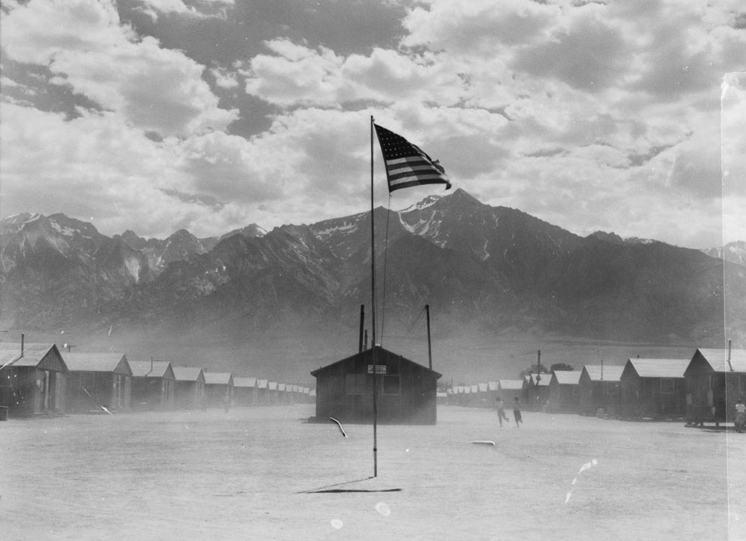
Japanese Internment 1942
Manzanar Relocation Center (Photo by: Dorthea Lang)
http://peopleus.blogspot.com/2010/10/japanese-internment-at-manzanar.html
Tim Thomas - t77@uw.edu

Slide 10

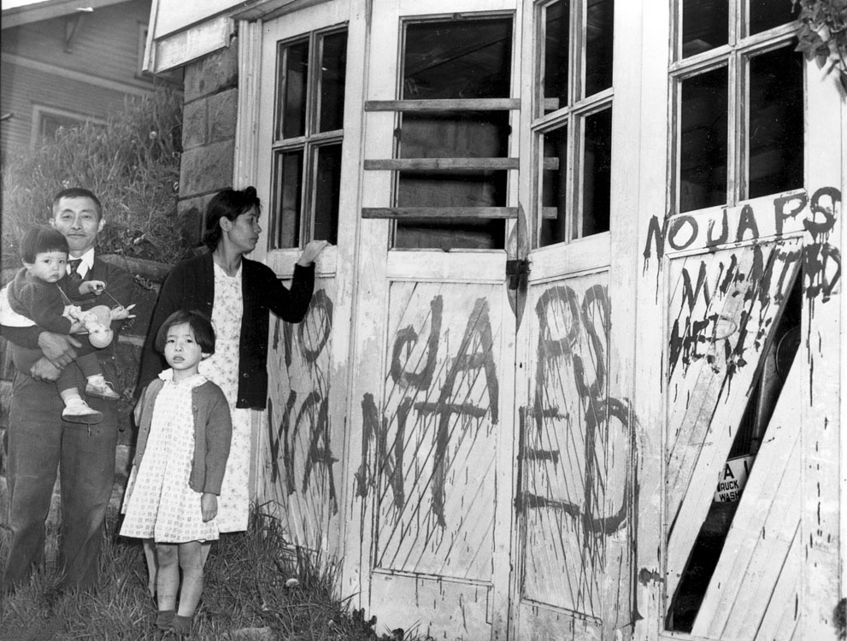
Japanese Internment 1942
Family Return: Hunt, Idaho (AP Photo)
http://peopleus.blogspot.com/2010/10/japanese-internment-at-manzanar.html
Tim Thomas - t77@uw.edu

Slide 11
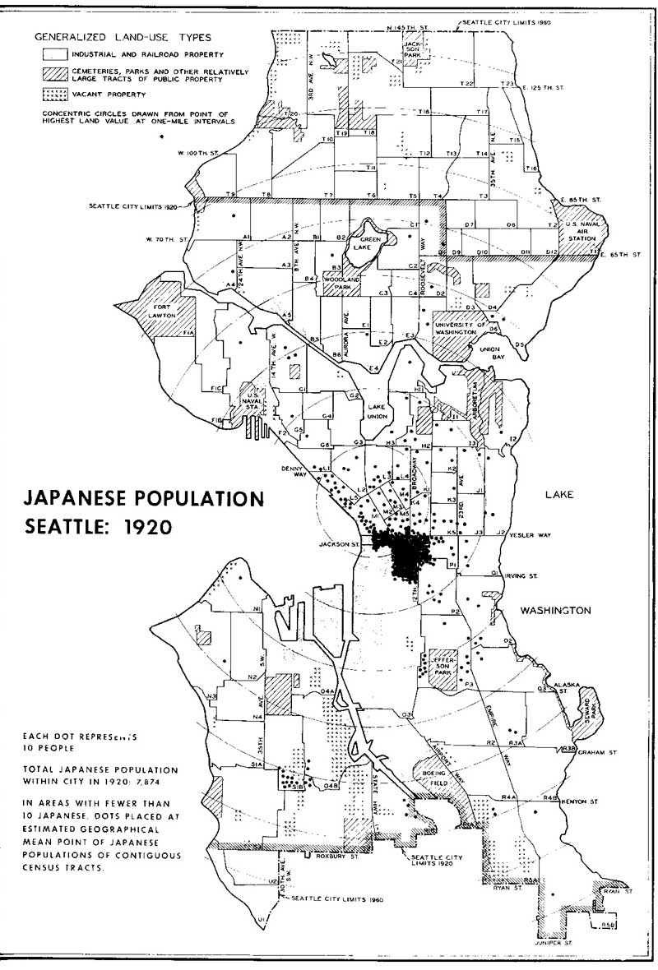
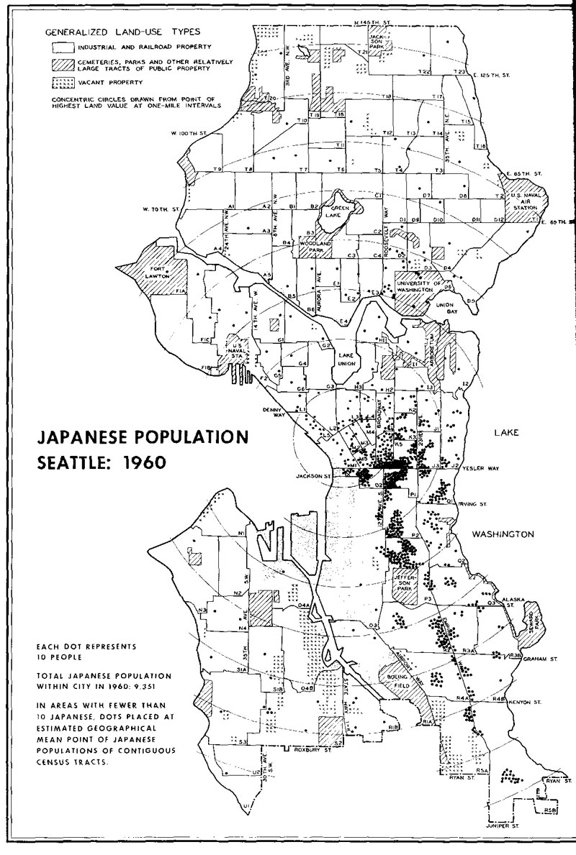
Japanese Population 1920 - 1960
1920
1960
Source: Seattle Civil Rights & Labor History Project
Tim Thomas - t77@uw.edu

Slide 12
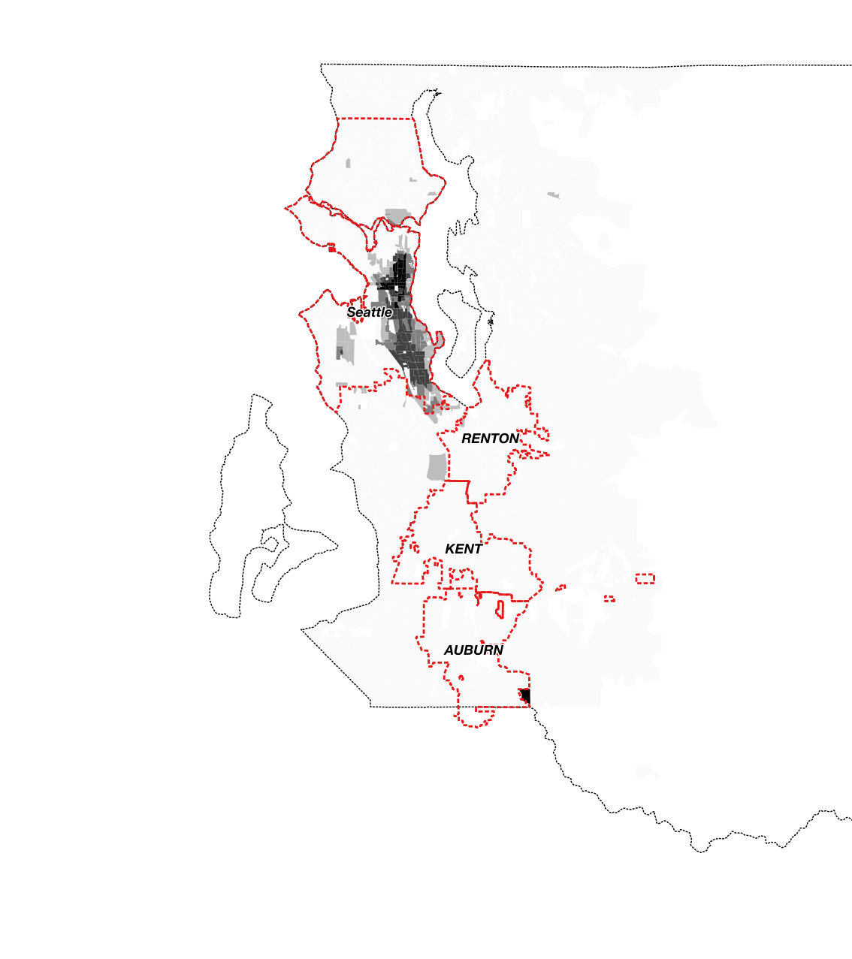
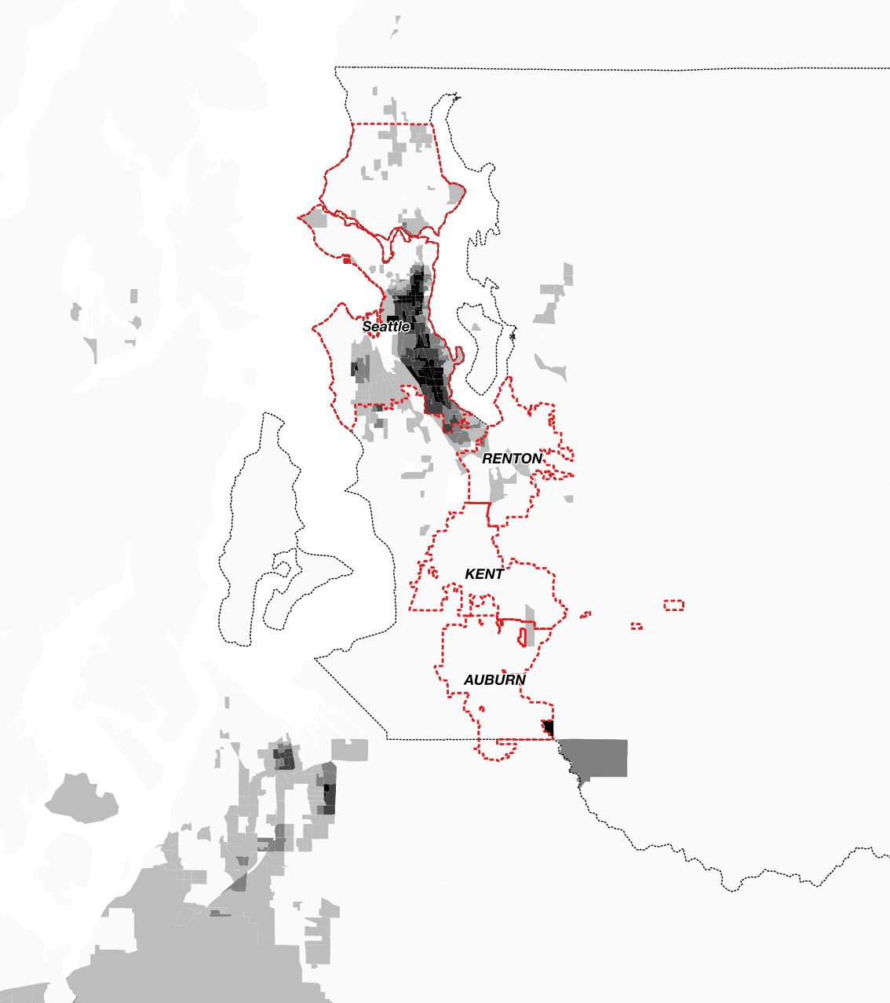
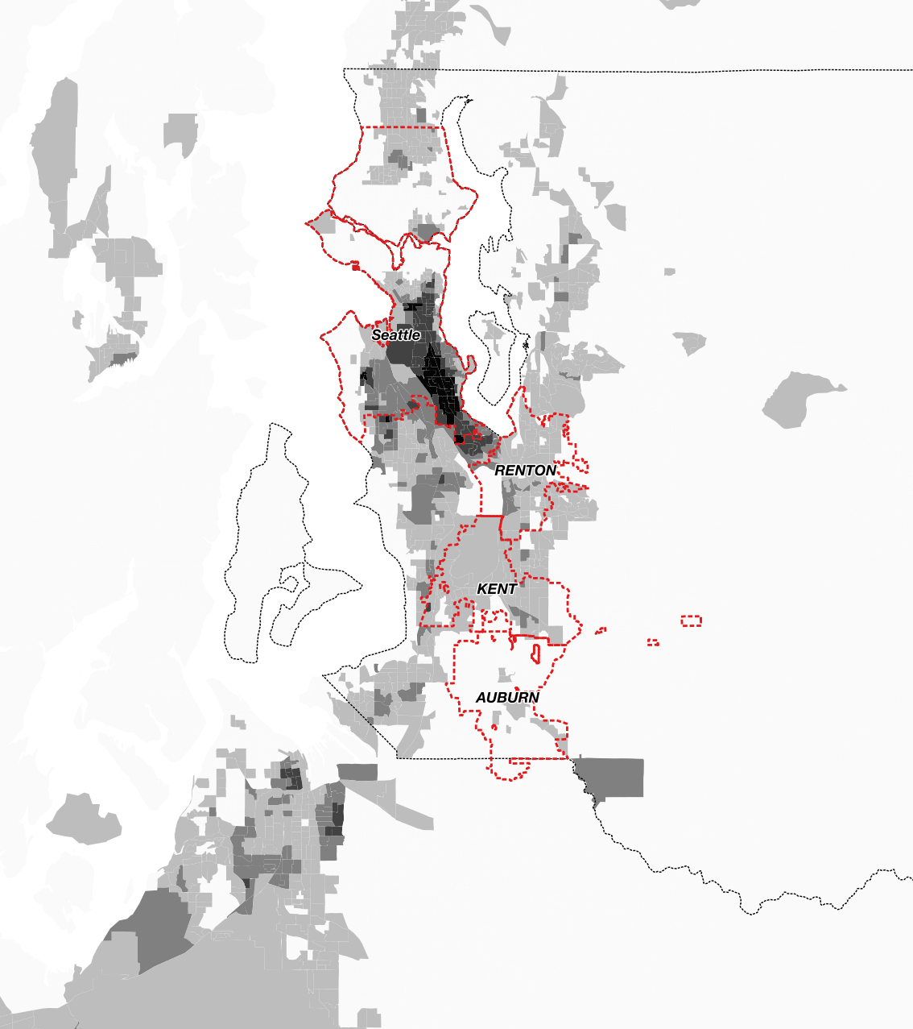
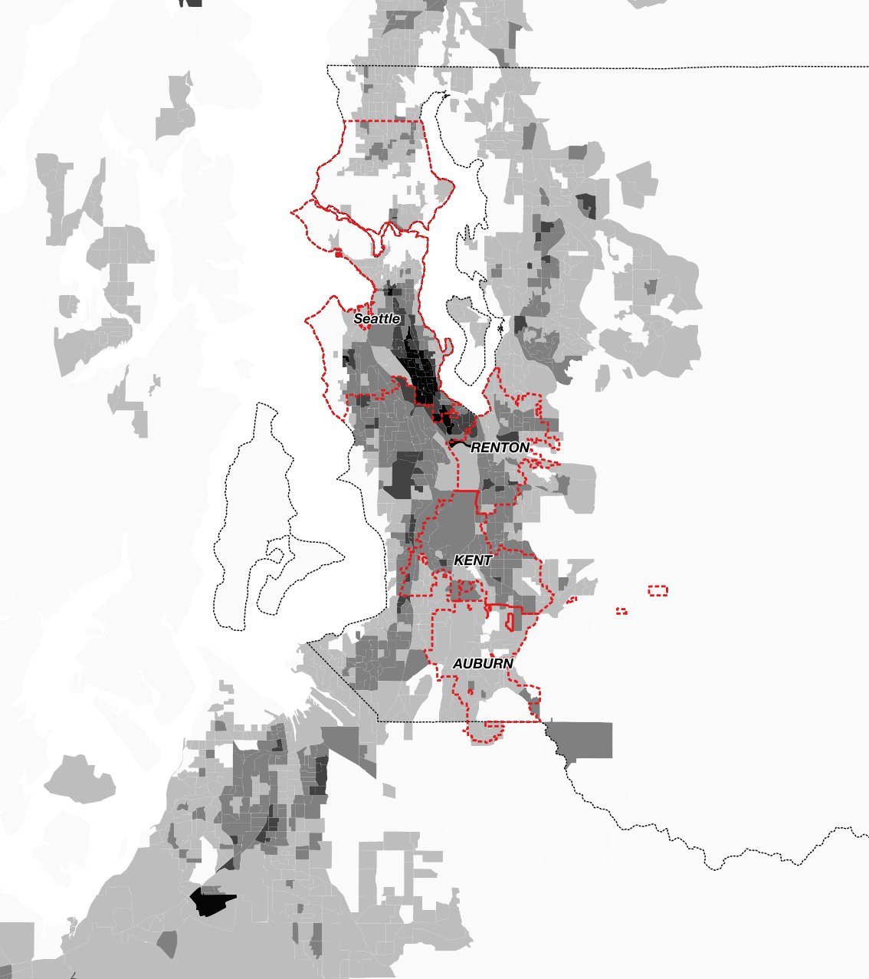
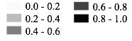
Non-White Mobility of 40 Years
1980
1990
2000
2010
Percent Non-white
0 - 20%
60 - 80%
20 - 40%
80 - 100%
40 - 60%
Tim Thomas, Department of Sociology, University of Washington, Source: U.S. Census
Notes:
What’s interesting about the integration story is that it could be a snapshot in time.

Slide 13
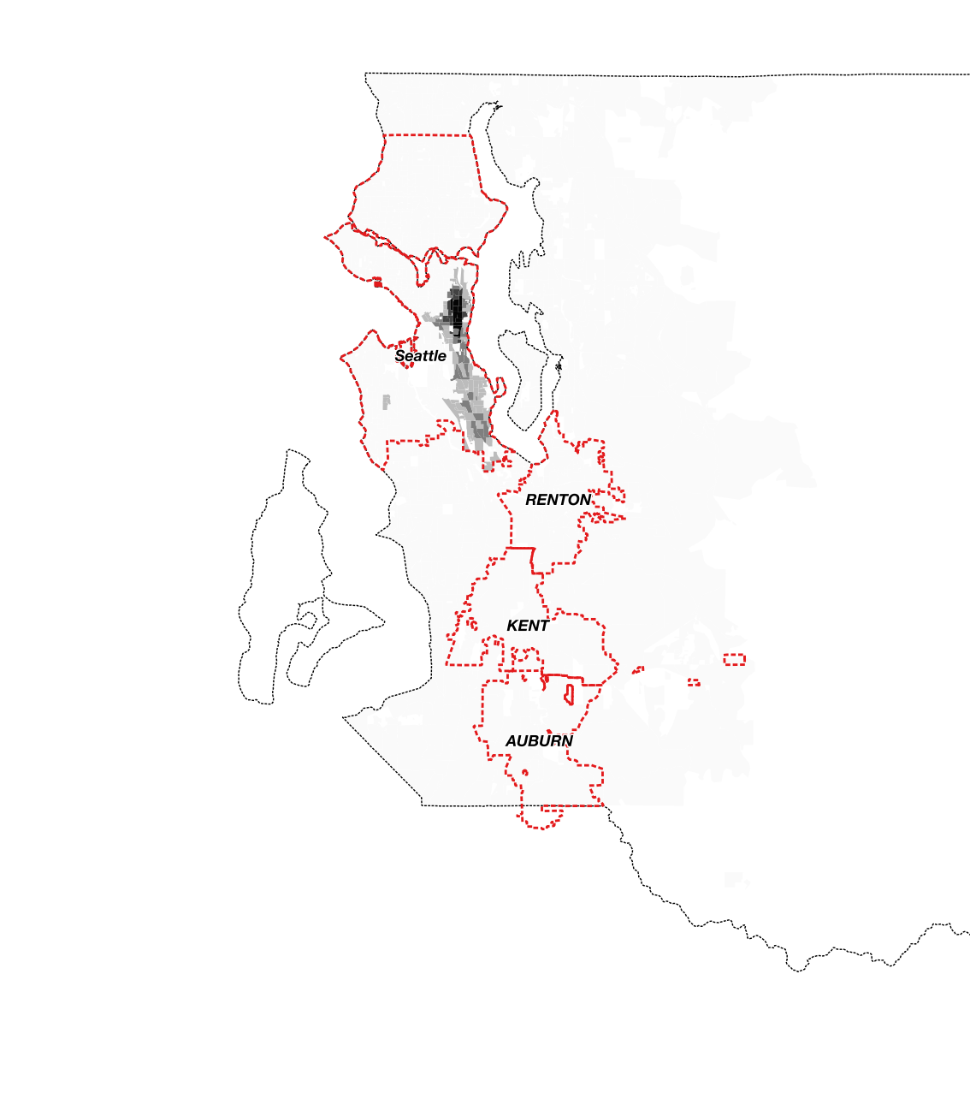
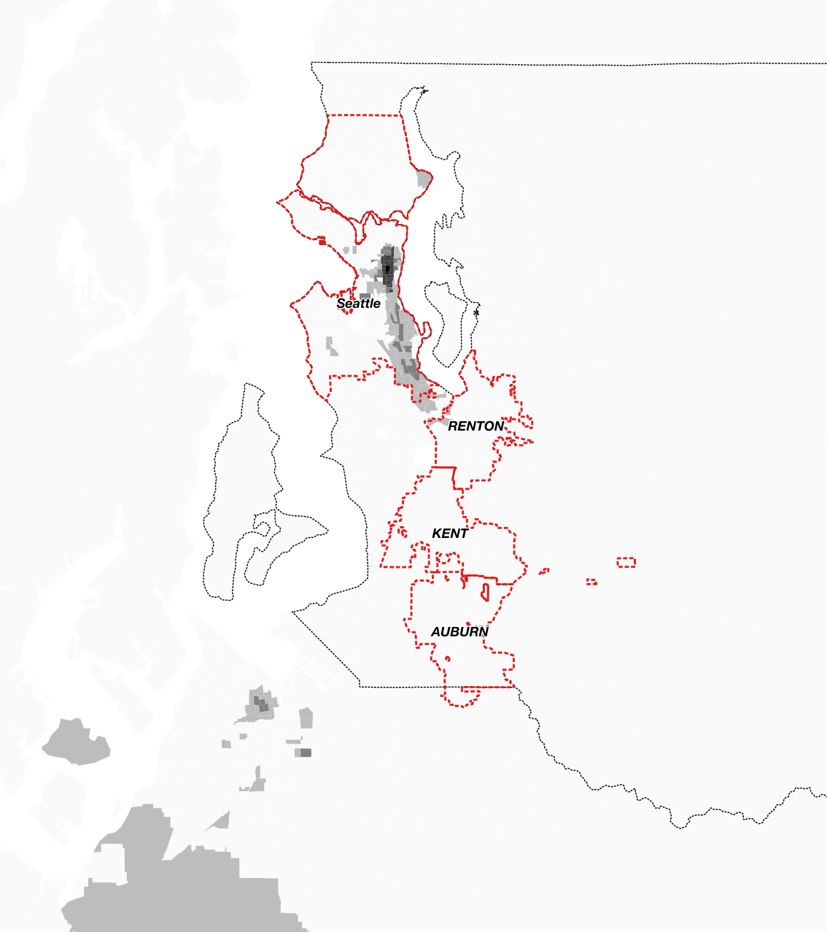
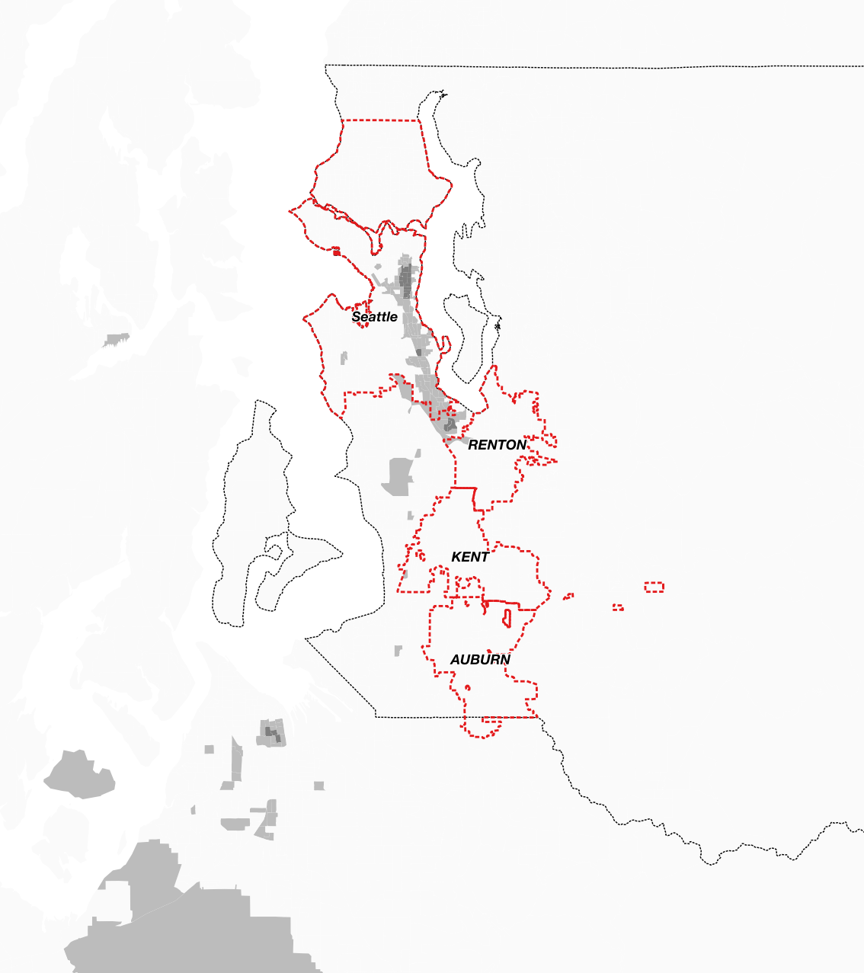
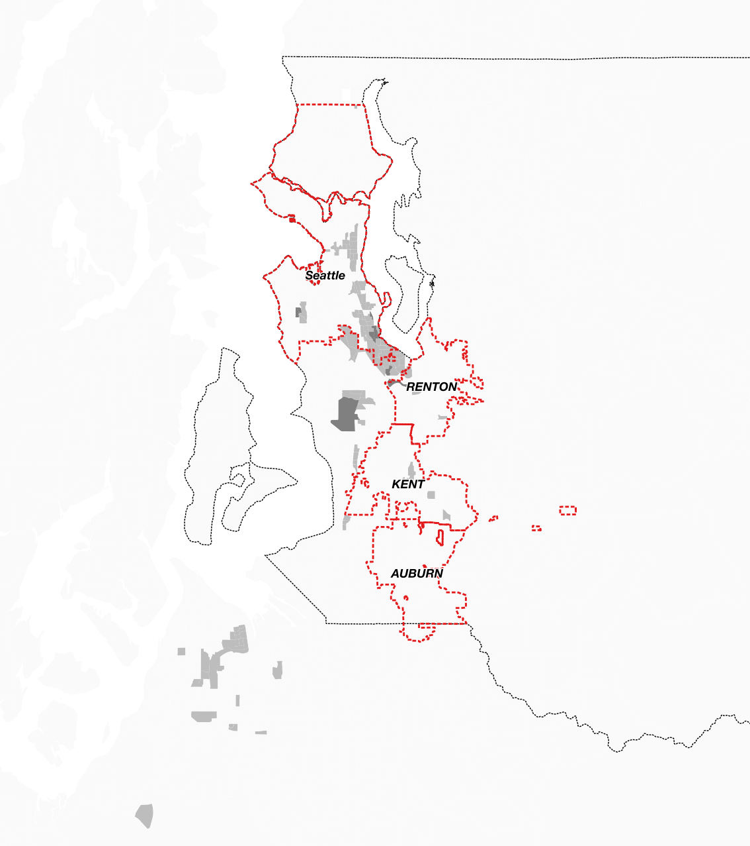
Black Mobility Over 40 Years
1980
1990
2000
2010
Percent Black
0 - 20%
60 - 80%
20 - 40%
80 - 100%
40 - 60%
Tim Thomas, Department of Sociology, University of Washington, Source: U.S. Census
Notes:
What’s interesting about the integration story is that it could be a snapshot in time.

Slide 14
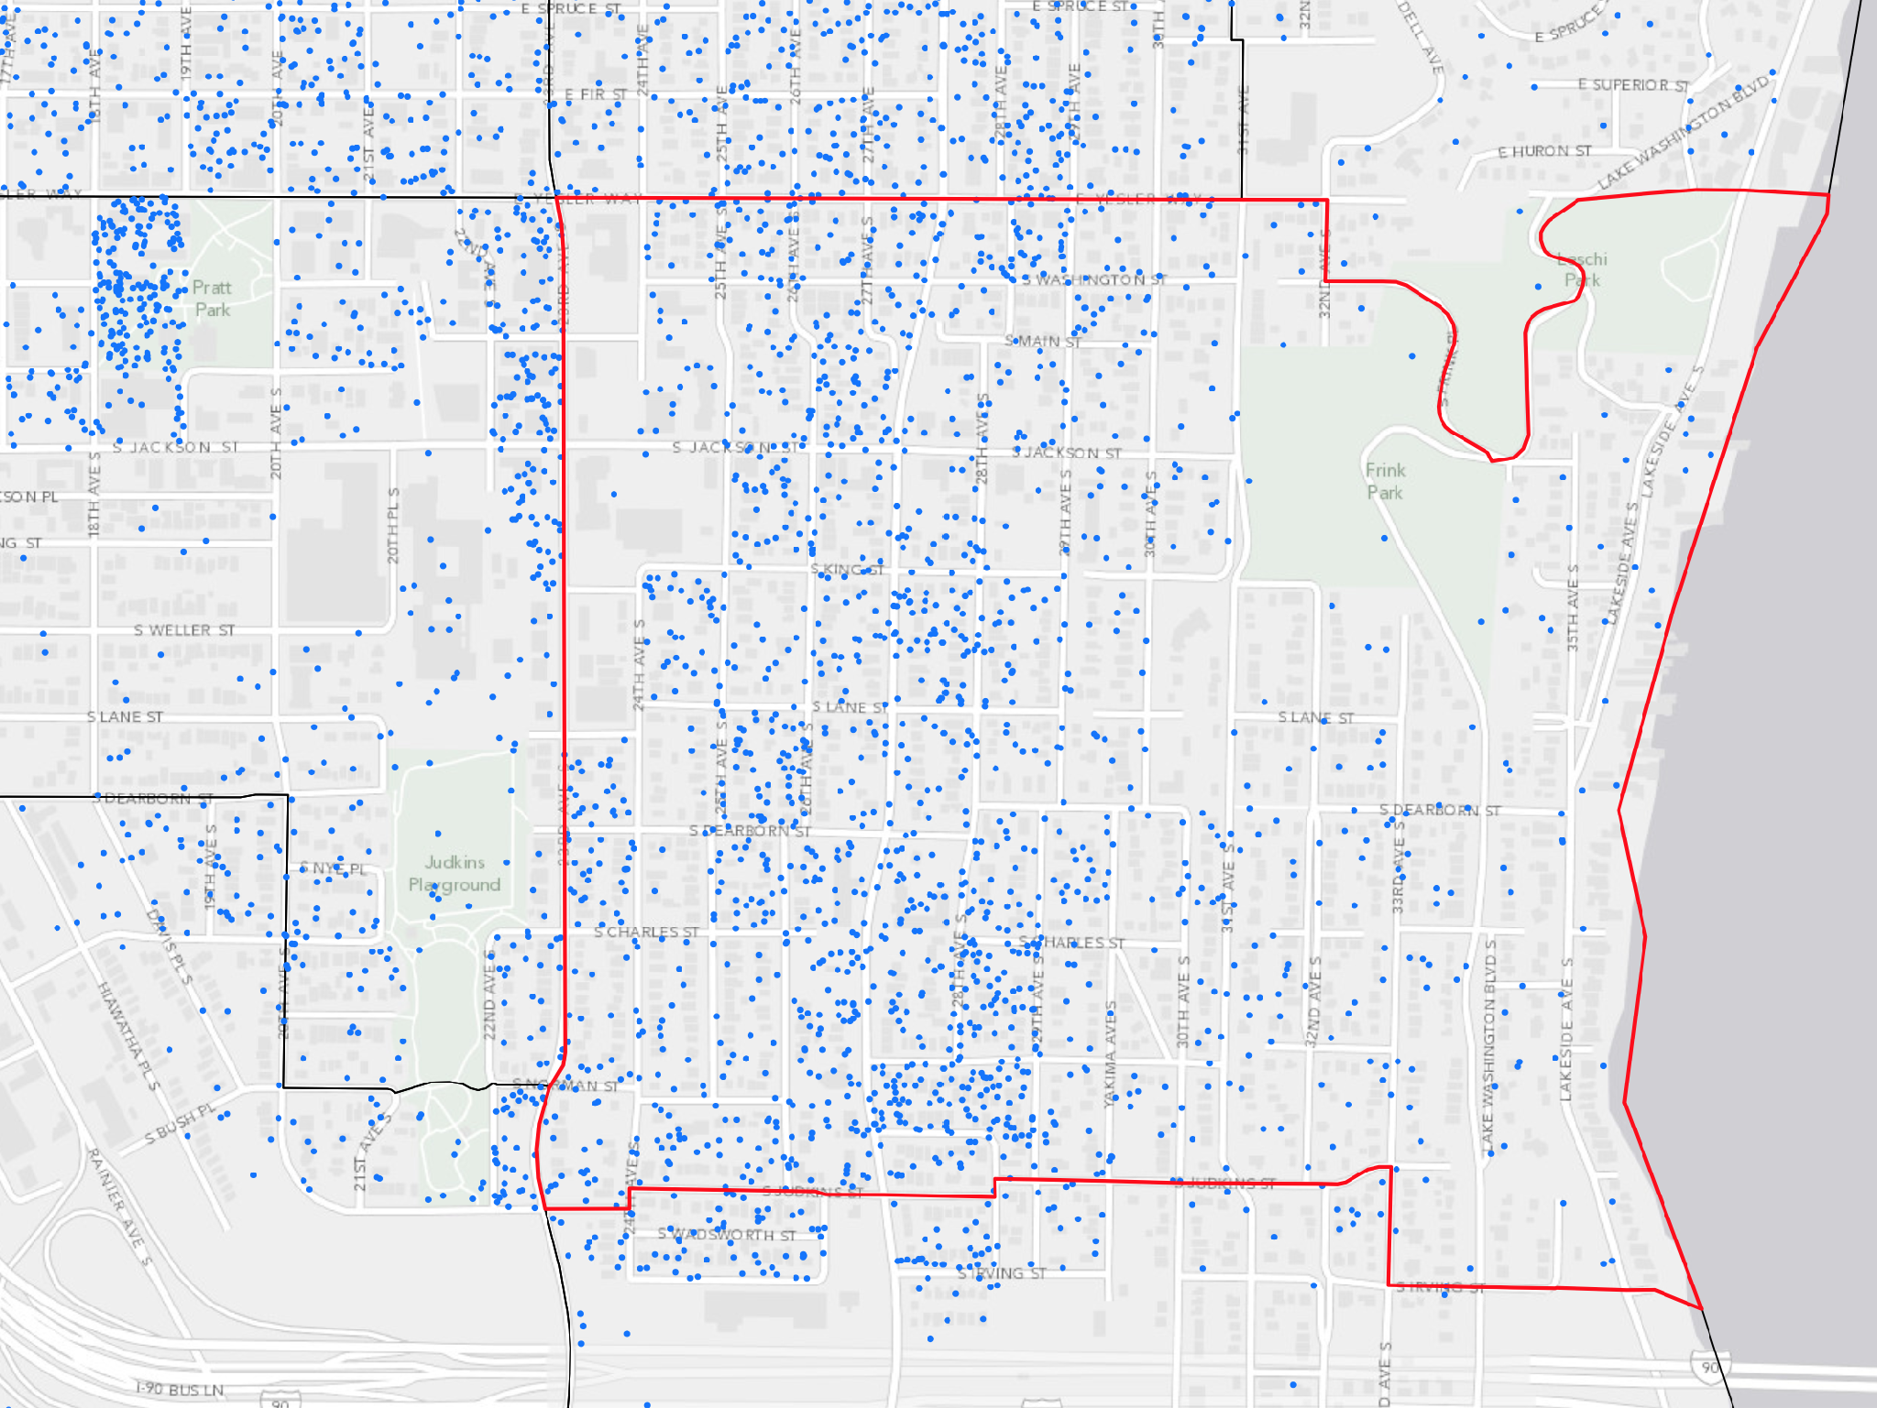
Central District
Tract 8900
Tract Fact
West Side Racial Distribution
White - 45%,
Asian - 53% Black - 78%
Tim Thomas - t77@uw.edu
Notes:
Ryan
Talk about percents
First line - 29th
Second line - 31st
Arrows - views of water - economic segregation

Slide 15
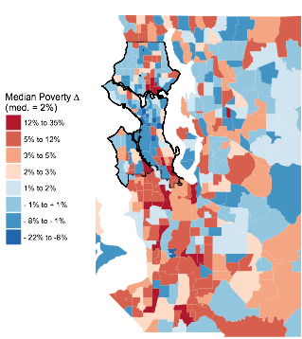
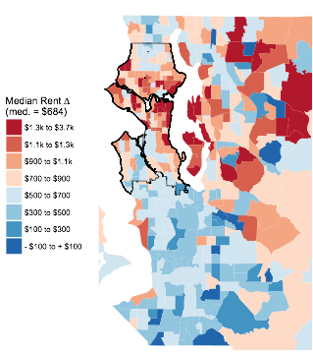
Neighborhood Change 2000 to 2016
Poverty
Rent
Similar to Black and Latino change
Similar to Education and New Movers
Tim Thomas - t77@uw.edu - bit.ly/seattleevictions

Slide 16
Gentrification & Displacement
Tim Thomas - t77@uw.edu - bit.ly/seattleevictions

Slide 17
Ecology of the City
Invasion/Succession
Concentric Zone Theory (Burgess 1925)
Competition
Conflict
Accommodation
Political Economy
Growth Machine (Logan and Molotch 1987)
“…the city's growth is guided by a coalition of monied land interests.”
Monied win, poor & minority lose
Tim Thomas - t77@uw.edu - bit.ly/seattleevictions
Notes:
…With burgeoning literature on neighborhoods effects, there hasn’t been extensive analysis of how neighborhood dynamics are associated with evictions.

Slide 18
Stages of Gentrification
Stages of Gentrification
Sweat Equity in Low-Income Neighborhoods
Tolerant White households with little money and a lot of elbow grease move in
Mostly artists and socially disenfranchised
Begins to enhance tax-base and increases socioeconomic integration
Young Families
Little more capital, seeking cheaper single-family housing near urban core/business districts
Voting and reshaping area in their favor
Attracting early political and market interest and investment
Displacement begins
Risky Investment
Lending and small-time development
New restaurants, amenities, and infrastructure to accommodate growing/wealthier population
Social services start to disappear or are pushed out
Large Scale Development
High-rise building and business establishment
Full demographic shift & change in political interests
Tim Thomas - t77@uw.edu - bit.ly/seattleevictions
Notes:
…With burgeoning literature on neighborhoods effects, there hasn’t been extensive analysis of how neighborhood dynamics are associated with evictions.

Slide 19
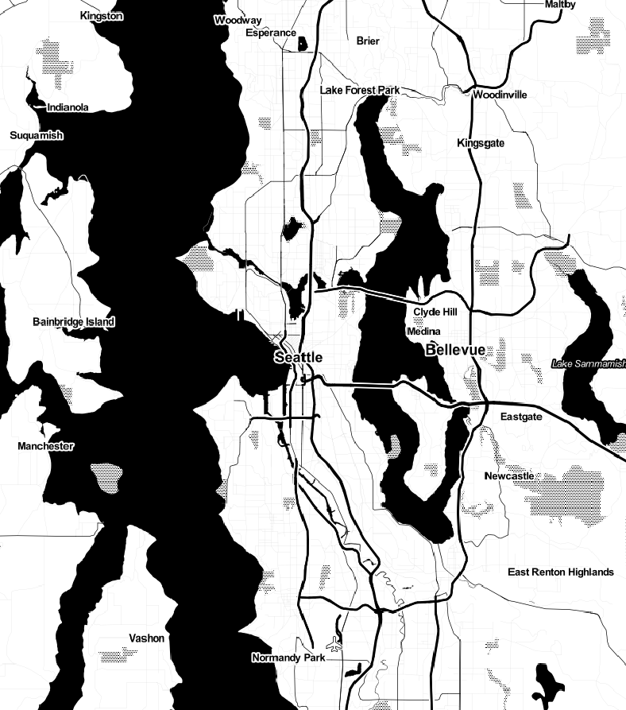
Displacement Tier Theory
Tier Theory
Tier 3
Tier 2
Tier 1
2016
Data: US Census American Community Survey
Tim Thomas - t77@uw.edu - bit.ly/seattleevictions
Notes:
…With burgeoning literature on neighborhoods effects, there hasn’t been extensive analysis of how neighborhood dynamics are associated with evictions.

Slide 20
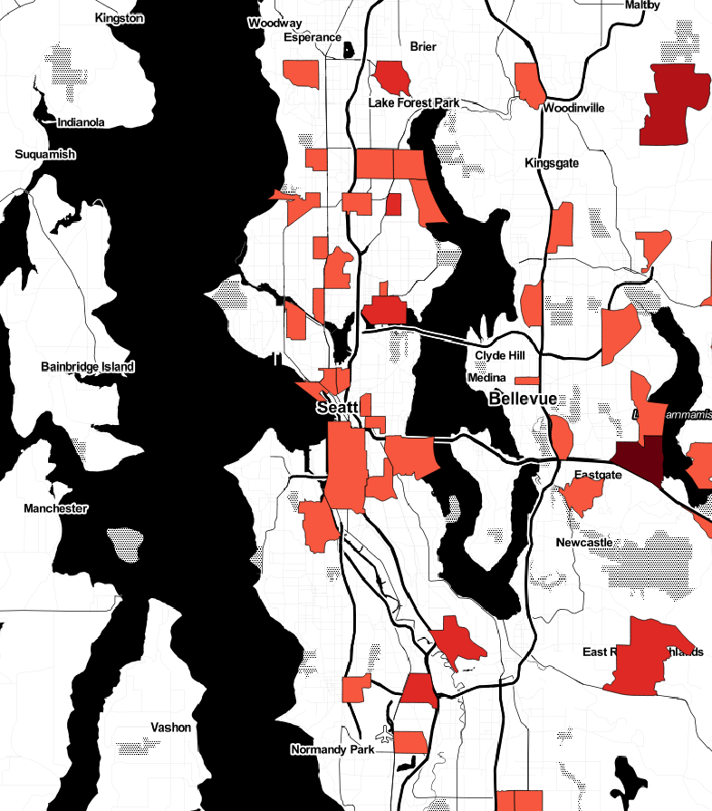
Displacement Tier Theory
Tier Theory
Tier 1
White migrants from
out-of-county
Tier 3
Tier 2
Tier 1
2016
Data: US Census American Community Survey
Tim Thomas - t77@uw.edu - bit.ly/seattleevictions
Notes:
…With burgeoning literature on neighborhoods effects, there hasn’t been extensive analysis of how neighborhood dynamics are associated with evictions.

Slide 21
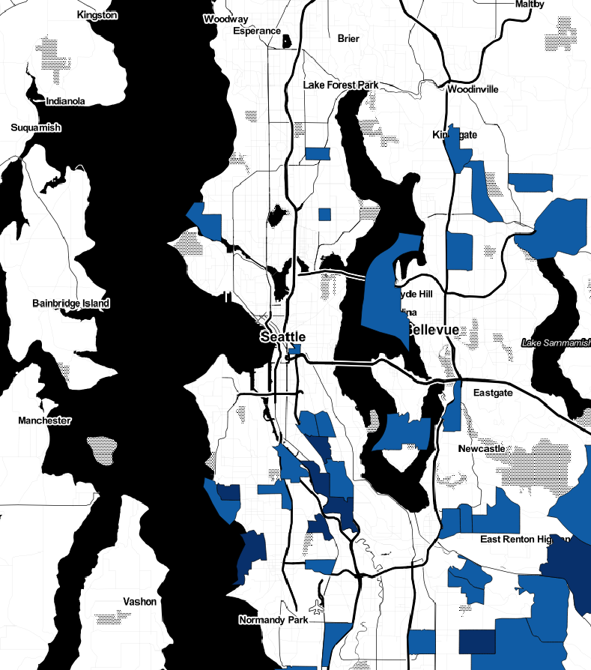
Displacement Tier Theory
Tier Theory
Tier 1
White migrants from
out-of-county
Tier 2
White migrants from
within-county
Tier 3
Tier 2
Tier 1
2016
Data: US Census American Community Survey
Tim Thomas - t77@uw.edu - bit.ly/seattleevictions
Notes:
…With burgeoning literature on neighborhoods effects, there hasn’t been extensive analysis of how neighborhood dynamics are associated with evictions.

Slide 22
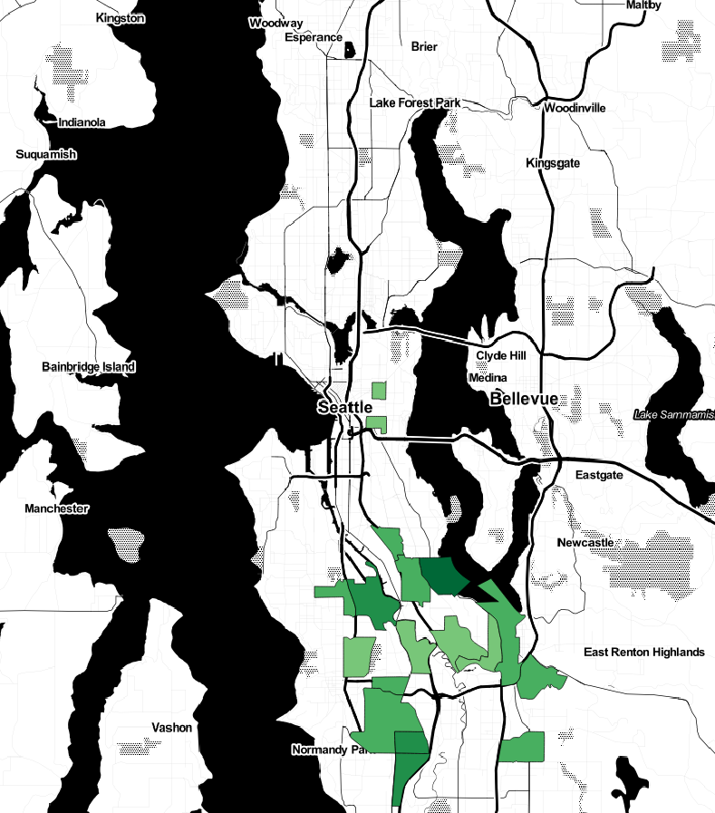
Displacement Tier Theory
Tier Theory
Tier 1
White migrants from
out-of-county
Tier 2
White migrants from
within-county
Tier 3
Black migrants from
within-county
Tier 3
Tier 2
Tier 1
2016
Data: US Census American Community Survey
Tim Thomas - t77@uw.edu - bit.ly/seattleevictions
Notes:
…With burgeoning literature on neighborhoods effects, there hasn’t been extensive analysis of how neighborhood dynamics are associated with evictions.

Slide 23
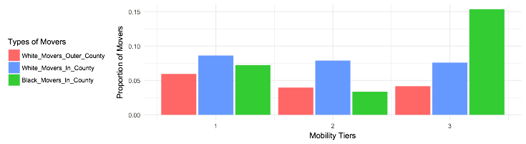
Displacement Tier Theory
Tier Theory
Tier 1
White migrants from
out-of-county
Tier 2
White migrants from
within-county
Tier 3
Black migrants from
within-county
Tier 3
Tier 2
Tier 1
2016
Data: US Census American Community Survey
Tim Thomas - t77@uw.edu
Notes:
…With burgeoning literature on neighborhoods effects, there hasn’t been extensive analysis of how neighborhood dynamics are associated with evictions.

Slide 24
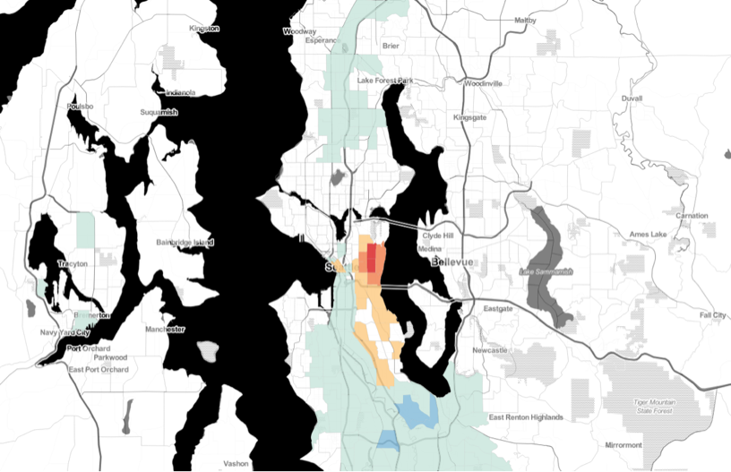
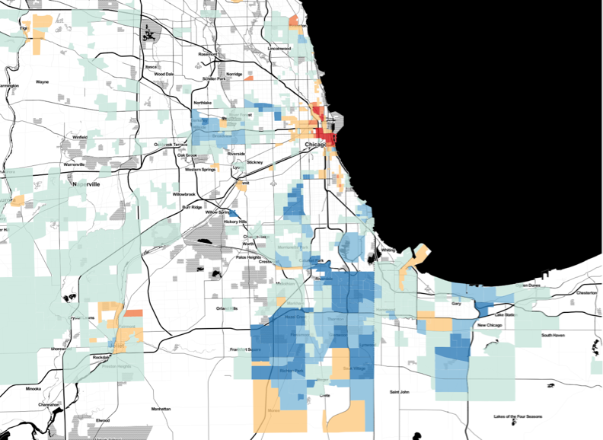
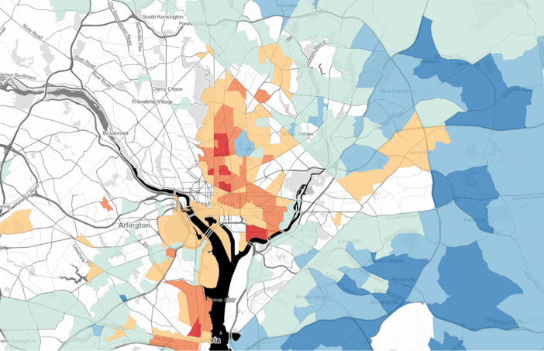
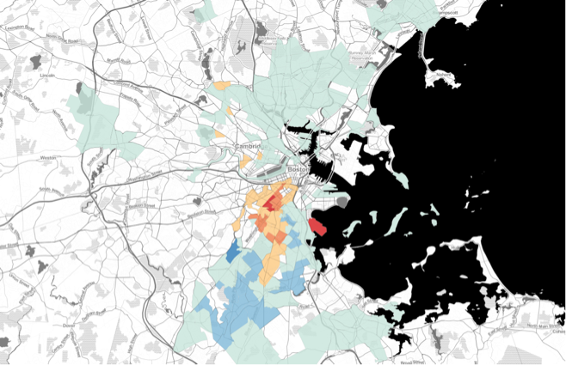
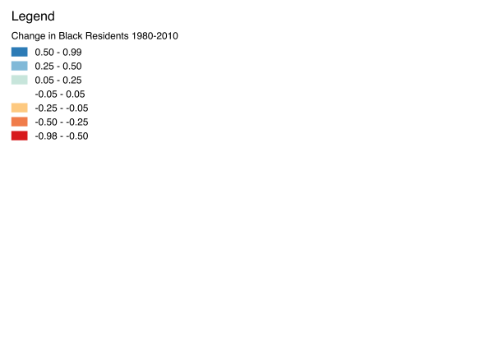
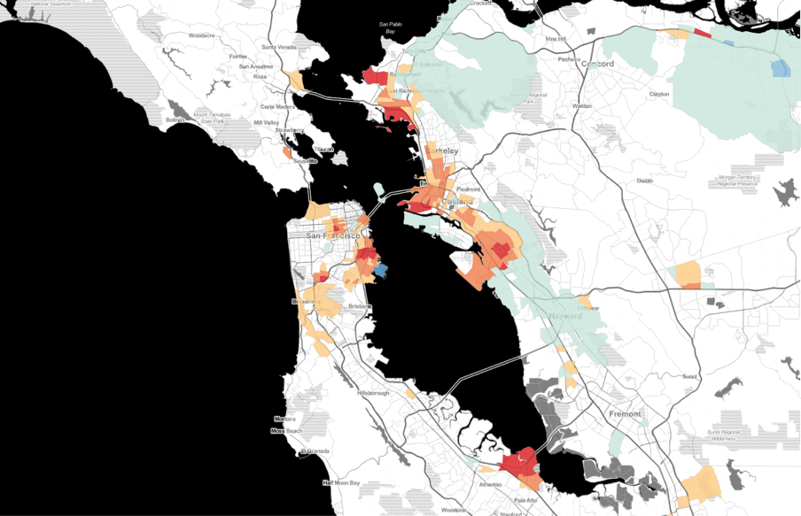
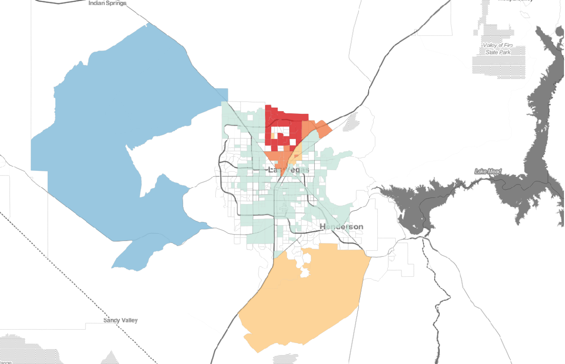
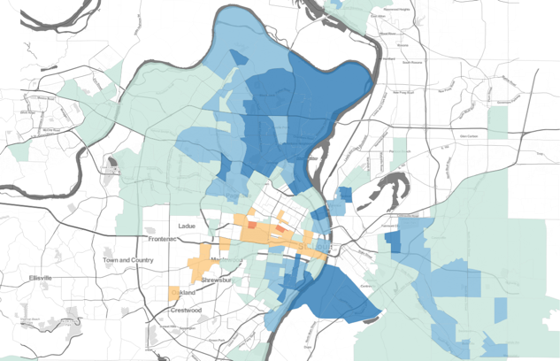
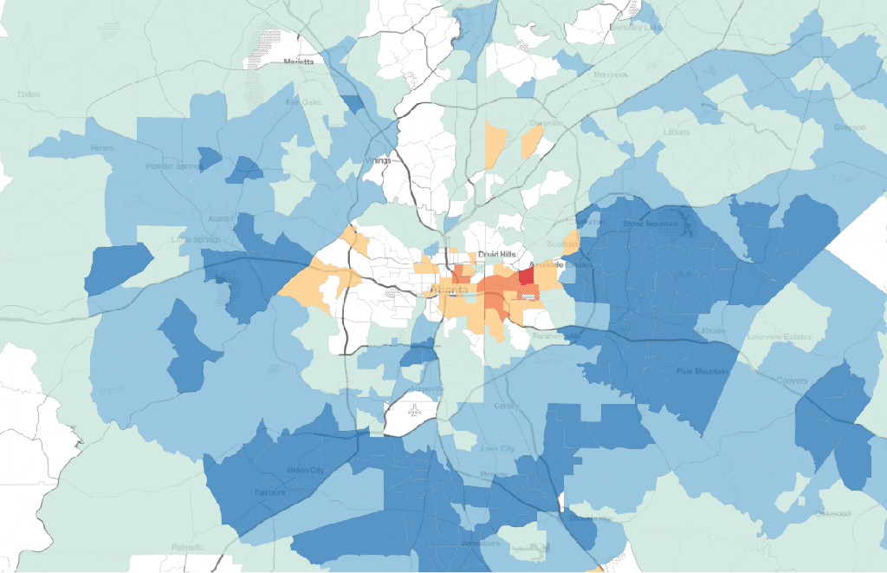
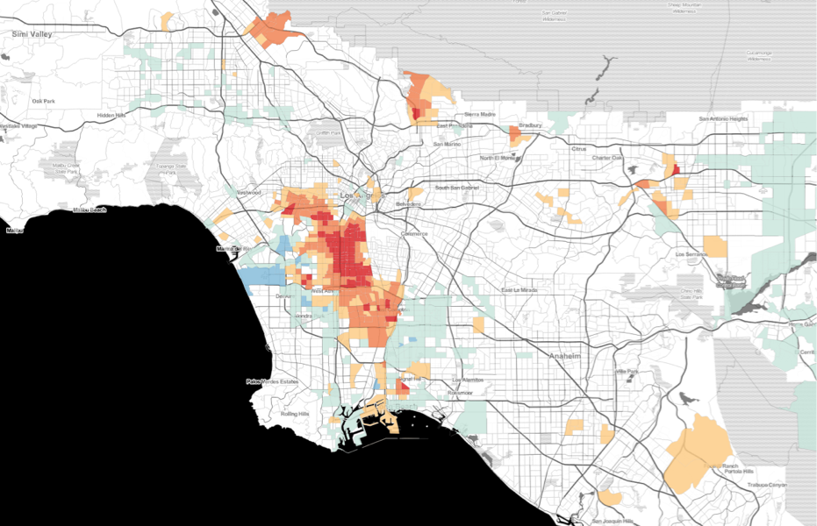
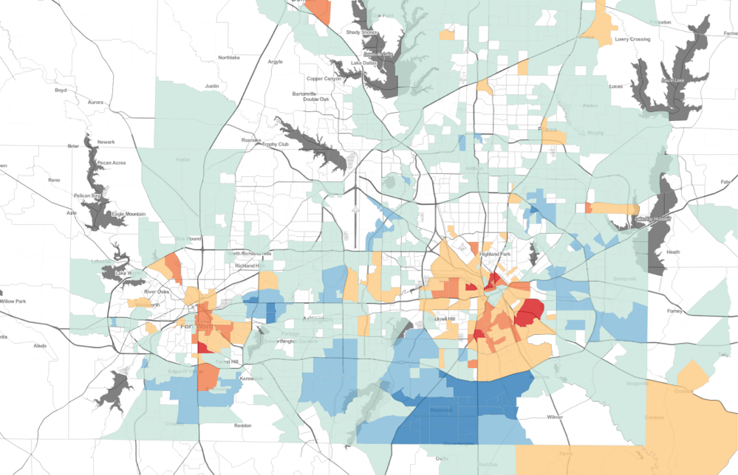
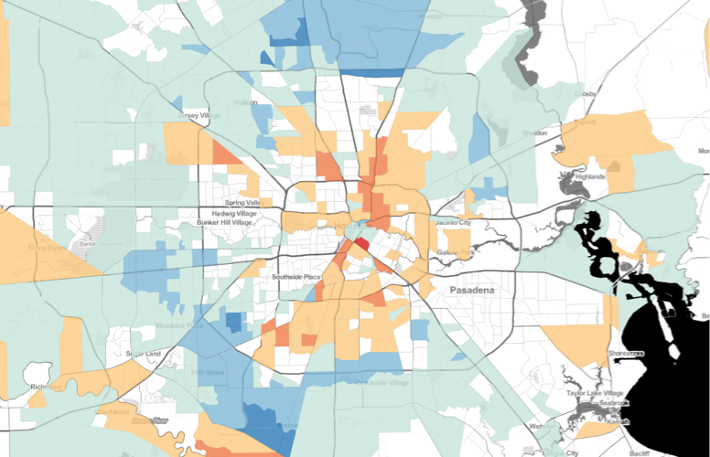
Black Decline in Urban Centers: 1980 - 2010
Seattle
Chicago
Washington DC
Boston
Percent Point
Change in Black
San Francisco
Las Vegas
St. Louis
Atlanta
Los Angeles
Dallas / Fort Worth
Houston
Tim Thomas - t77@uw.edu

Slide 25
Evictions
Tim Thomas - t77@uw.edu - bit.ly/seattleevictions

Slide 26
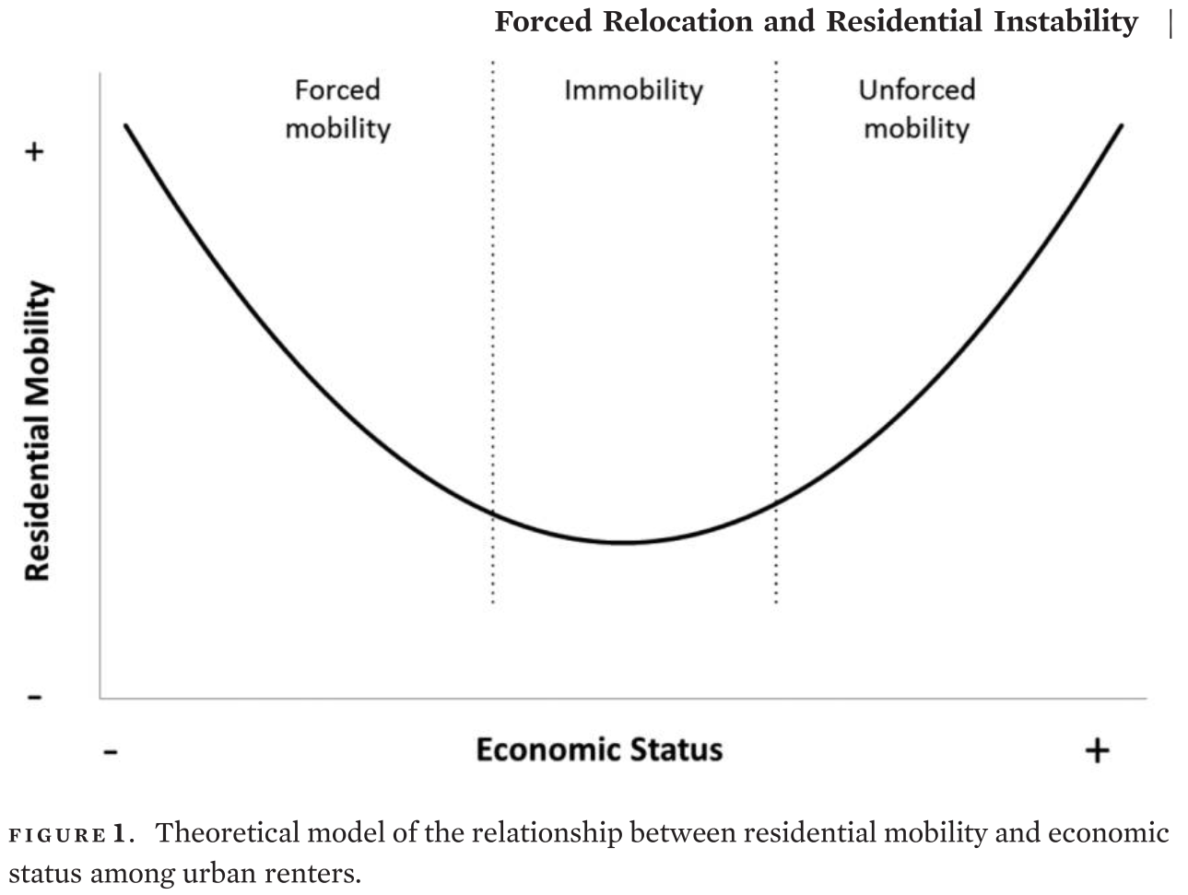
Forced Relocation & Residential Instability
Desmond, Matthew, Carl Gershenson, and Barbara Kiviat. 2015. “Forced Relocation and Residential Instability among Urban Renters.” Social Service Review 89(2):227–62.
Tim Thomas - t77@uw.edu - bit.ly/seattleevictions
Notes:
From a scholarly perspective, research on evictions provides a more comprehensive model between residential and financial stability and mobility
* Graph: Relationship between residential mobility and economic status among urban renters
Most research has focused on latter 2/3 of this graph where households have chosen to move based on resources

Slide 27
Forced Relocation & Residential Instability
Desmond, Matthew, Carl Gershenson, and Barbara Kiviat. 2015. “Forced Relocation and Residential Instability among Urban Renters.” Social Service Review 89(2):227–62.
Tim Thomas - t77@uw.edu - bit.ly/seattleevictions
Notes:
The evictions literature helps explain this section here

Slide 28
Increasing
Rent
Evictions
Housing
Burden
Inadequate
Welfare
Individual-Level Dynamics
Tim Thomas - t77@uw.edu - bit.ly/seattleevictions
Notes:
To get at a more comprehensive understanding (NEXT SLIDE)

Slide 29
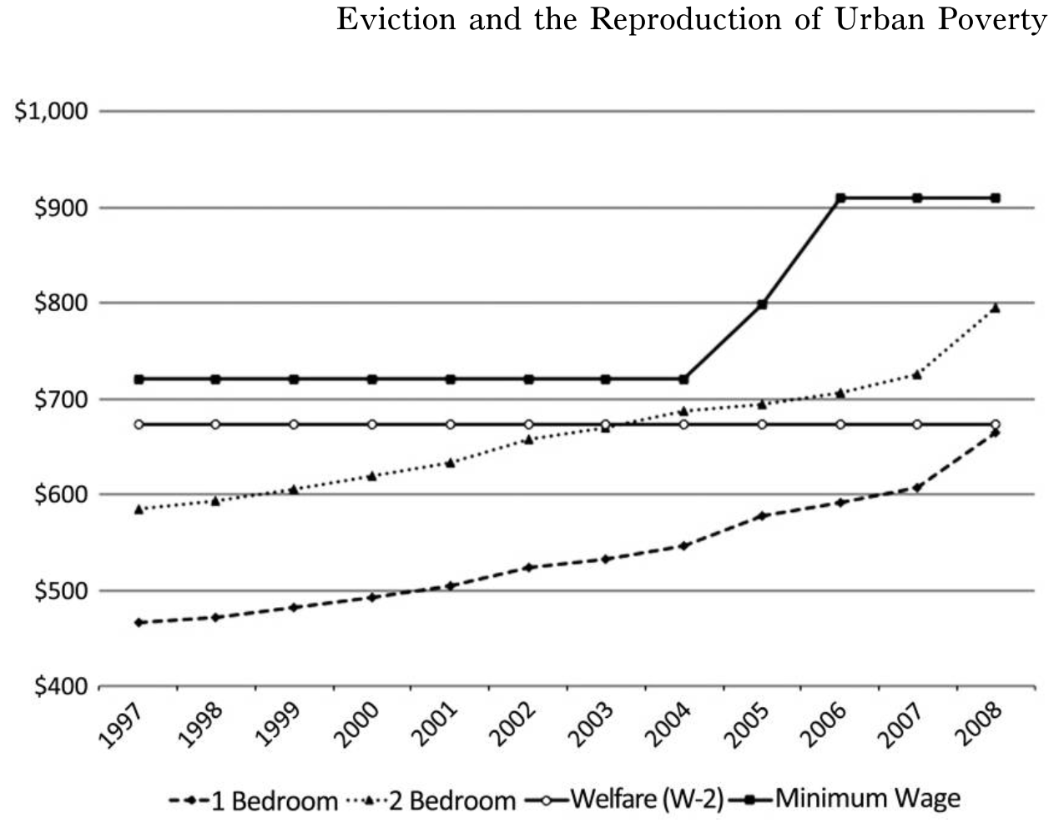
Individual Level Dynamics
Milwaukee Rent, Income, & Welfare
Desmond, Matthew. 2012. “Eviction and the Reproduction of Urban Poverty.” American Journal of Sociology 118(1):88–133.
Tim Thomas - t77@uw.edu - bit.ly/seattleevictions
Notes:
What we see is that wages and welfare stipends are unable to compete with rising rents
Even in poor neighborhoods…

Slide 30
Increasing
Rent
Evictions
Housing
Burden
Inadequate
Welfare
Individual-Level Dynamics
Tim Thomas - t77@uw.edu - bit.ly/seattleevictions
Notes:
To get at a more comprehensive understanding (NEXT SLIDE)

Slide 31
Neighborhood-Level Dynamics
Local & Extra-Local
Conditions
Neighborhood
Change
Location &
Concentration
Increasing
Rent
Evictions
Housing
Burden
Inadequate
Welfare
Individual-Level Dynamics
Tim Thomas - t77@uw.edu - bit.ly/seattleevictions
Notes:
I propose an analysis of neighborhood level effects that may relate to evictions.

Slide 32
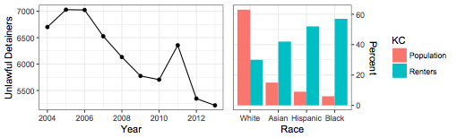
Evictions Data
Unlawful detainers by year
KC pop & renters
Unlawful Detainers
Formal evictions are heard and decided usually within 1 week
Despite resolution, the mark of an eviction stays on your record, like a criminal record
King County Renting Population
322,514 Households
63% White, 12.2% Asian,9.6% Latino, 9.6% black
Tim Thomas - t77@uw.edu - bit.ly/seattleevictions

Slide 33
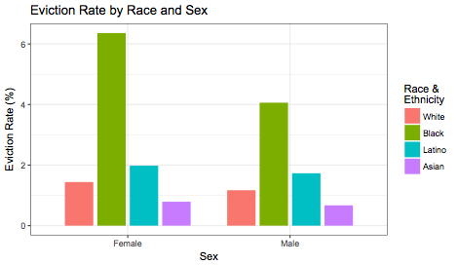
Eviction Rates by Sex & Race
Sex
Female head:
32% > male heads
Race
Black head:
4x > whites
Latinx head:
1.4x > whites
Sex & Race
Black female head:
4.4x > white fem.
5.4x > white male
Black male head:
3.5x > white male
UD Rates by Sex & Race
Tim Thomas - t77@uw.edu - bit.ly/seattleevictions
Notes:
black female headed households UD’s (6.36%) followed by
black male heads (4.06%),
Latino female heads (1.98%),
Latino male heads (1.73%).
whites, female heads were evicted 23%more (1.44%) than
white males (1.17%)
Rate Ratios
Black female to white female: 4.42
Black female to white Male: 5.44
Black male to white male: 3.46

Slide 34
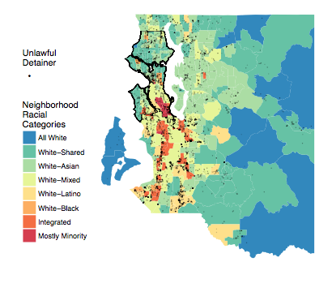
UD Distribution & Neigh. Types
Regional Distribution
S. King: 57%
Seattle: 27%
East: 15.2%
Other: 0.6%
Neighborhood Types
South:
Minority & integrated
Seattle & East:
White & Asian

Slide 35
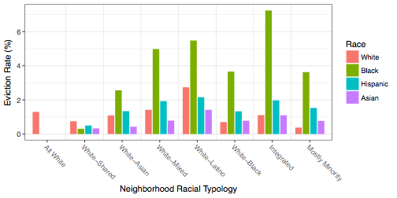
Neighborhood Type
Tim Thomas - t77@uw.edu - bit.ly/seattleevictions
Notes:
Integrated: black 6.5 times than white
Mostly minority: 9 times
WM WA WS WB WL Int
84 127 114 10 24 38

Slide 36
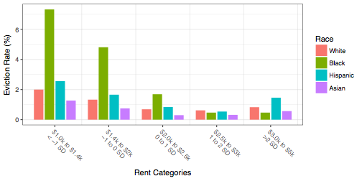
Rent
Tim Thomas - t77@uw.edu - bit.ly/seattleevictions

Slide 37
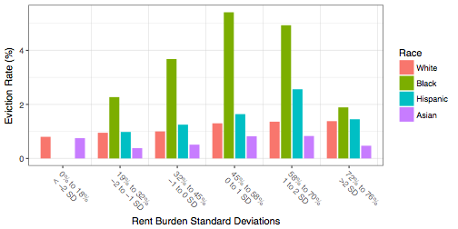
Rent Burden
Tim Thomas - t77@uw.edu - bit.ly/seattleevictions

Slide 38

Economic Differences
Seattle Median Household Income by Race
$103k
Data: US Census Decennial and American Community Survey and Housing and Urban Development
Tim Thomas - t77@uw.edu
Notes:
…With burgeoning literature on neighborhoods effects, there hasn’t been extensive analysis of how neighborhood dynamics are associated with evictions.

Slide 39

Economic Differences
Seattle Median Household Income by Race
$103k
80% AMI
50% AMI
30% AMI
Data: US Census Decennial and American Community Survey and Housing and Urban Development
Tim Thomas - t77@uw.edu
Notes:
…With burgeoning literature on neighborhoods effects, there hasn’t been extensive analysis of how neighborhood dynamics are associated with evictions.

Slide 40
Economic Differences
2br Apt in 2018
$2,200 x 12
30% rent burden
=
Income
$88,000
Seattle Median Household Income by Race
$103k
80% AMI
50% AMI
30% AMI
Data: US Census Decennial and American Community Survey and Housing and Urban Development
Tim Thomas - t77@uw.edu
Notes:
…With burgeoning literature on neighborhoods effects, there hasn’t been extensive analysis of how neighborhood dynamics are associated with evictions.

Slide 41
Take Aways
Non-White, middle-class, & the Creative Class are vulnerable to displacement.
The history of segregation & economic/housing exclusion created concentrated poverty in the urban core. Now, the problems of the early city are found in the suburbs: declining infrastructure, redirected investments, increases in poverty.
Richard Florida suggested how to build a city to attract the Creative Class. Sixteen years later, it created economic growth for the already wealthy while displacing the poor and working class.
Bold steps are necessary to curb formal and informal displacement.
Continue to raise awareness of race, ethnic, gender, sexual identity/orientation, and economic disparities and how they affect everyone.
Design policies and strategies that help vulnerable groups. For example, consider changing how evictions are handled in the renting process.
Increase the political clout and economic resources for vulnerable groups. They are highly invested in the culture and ethos of Seattle and they can not afford to stay. Empower the community to help their own neighbors.
The public, practitioners, and academics need more data, resources, & communication regarding research related specifically to the changing city.
A formal study/survey of displaced households would help explain mechanisms of gentrification.
Researchers need to know what is important for practitioners and the city so they can ask relevant questions.
Tim Thomas - t77@uw.edu - bit.ly/seattleevictions
Notes:
…With burgeoning literature on neighborhoods effects, there hasn’t been extensive analysis of how neighborhood dynamics are associated with evictions.

Slide 42
Current Research:
Housing Insecurity Longitudinal Database (HILD)
Expand evictions data
Merge datasets
Measure transitions between these three
Individual & neighborhood characteristics
Evictions
Public Housing
Homelessness
Tim Thomas - t77@uw.edu - bit.ly/seattleevictions

Slide 43
Thank you
Tim Thomas, Ph.D
Postdoctoral Fellow
University of Washington
eScience Institute & Sociology
t77@uw.edu
Tim Thomas - t77@uw.edu - bit.ly/seattleevictions
Notes:
Thank you!
Ecology of Evictions

Slide 44

Economic Differences
King County Median Household Income by Race
$103k
80% AMI
50% AMI
30% AMI
Data: US Census Decennial and American Community Survey and Housing and Urban Development
Tim Thomas - t77@uw.edu
Notes:
…With burgeoning literature on neighborhoods effects, there hasn’t been extensive analysis of how neighborhood dynamics are associated with evictions.

Slide 45

US Wealth Gap
Source: http://apps.urban.org/features/wealth-inequality-charts/
Tim Thomas - t77@uw.edu

Slide 46


Pre Operation
Jul-Sep 2010
Post Operation
Jan-Mar 2011
Notes:
Here’s a comparison between the two time periods.

Slide 47


Marijuana Legalization

Slide 48


Health and Segregation
What we know:
Average sleep & neighborhood types
What we don’t know:
Variation within neighborhood types
Thomas & Esposito
Notes:
…With burgeoning literature on neighborhoods effects, there hasn’t been extensive analysis of how neighborhood dynamics are associated with evictions.

Slide 49


Health and Segregation
Metro segregation &
proportion Black
Predicted sleep problems & proportion black

